Slide 1

Optimizing the limitations of OSM System
Ministry Category : Minister of HRD
Problem Code : #CBS3
Problem Statement : Evaluation of Answer Book
College Code : 0822 (SVCE INDORE)
Team Leader Name : Priya Parwani
Also it can act as a step forward towards

Slide 2

Our Idea
Our idea kicks off a new speculation and goals for vision of our honorable PM Mr. Narendra Modi of “Integrated, Smart and Digital India”.
Using Barcode Technology, we ought to arrange the marking scheme, in accordance with the order of questions that are attempted by students in non serial order.
Our innovation, initiates by providing the barcode stickers in two phases:-
Phase 1 > A single barcode stickers will be provided to students containing their respective information required for examination. This will replace the conventional OMR system.
Phase 2 > Each Questions will be assigned a unique barcode, and these stickers will be provided to students at the end of the exam. Students have to paste the barcodes strictly in accordance with the order of questions attempted by them so as to justify the sequence of the questions to the evaluator.
Every answer number in the marking scheme will be allotted the same barcode as that of the respective question.
The barcodes attached by the students on the answer sheet will be scanned, as a result the marking scheme will get rearranged in the same order as attempted by the student.

Slide 3
Technology Used
Software Requirements:
 | Front-End | Back-End
IDE | Netbeans IDE 8.2 | Oracle 10 G Express edition
Programming Language | Core Java | MySQL
System Requirements:
Operating System | Windows 7/8/8.1/10
Processor | Intel Pentium 3g
Hard-disk (space) required | 20 GB
RAM required | 2 GB or higher
JVM | JDK 8.1
Windows Requirements | Windows NT Server
Network Protocol | TCP/IP with SSL
API Required | Barcode Reader API

Slide 4
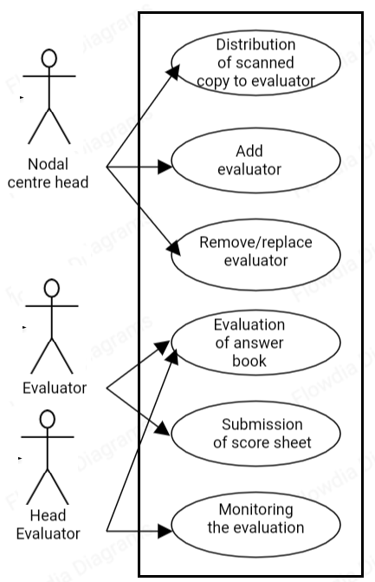
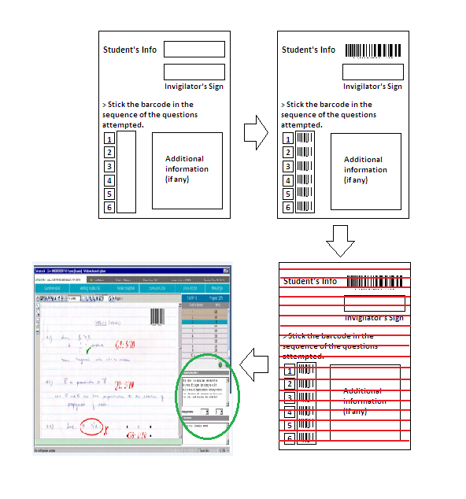
Use Case Diagram
Step1
Step 2
Sample answer sheet
Filled answer sheet
Evaluation of answer sheet in OSM
Step 4
Step 3
Scanning of answer sheet
Sorted Marking Scheme
(acc. to the sequence of stickers)
Fig. 02 : Process Diagram
Fig. 01: Use Case Diagram

Slide 5
Process of Execution
step 1
Students will be provided with a bar code sticker containing the student information required by the exam center.
step 2
At the end of the examination the students will be provided with the set of stickers, containing the barcodes encoded with the question number.
The students will then have to stick the barcodes of the question strictly in accordance with the sequence in which they have attempted the questions.
step 3
step 4
Firstly ,the barcode of the students information is decoded.
Then, question number and their sample answers in the marking scheme are assigned the same barcode. As soon as the barcodes of the question serial are scanned their respective marking scheme is called.
By the end of this scanning the marking scheme is arranged in the same sequence in which the student has attempted the question.
step 5
The evaluator checks the scanned images of the answer sheet and the marksheet is automatically generated and is submitted to head evaluator.
All the answer sheets are sent to the nodal center where they are scanned and barcode are decoded and rest of the scanned images are forwarded to the evaluator for the further process.

Slide 6
Key Features Of Our Software
Use of barcodes to get the non-serial order of questions as attempted by the students as well as getting marking scheme sorted in the same order.
Security of candidate's information
Evaluator’s manual work is reduced by many folds.
Biased evaluation is not acceptable by the software as :
1. It does not allow evaluator to award marks for the unanswered questions.
2. There is no possibility of any calculation mistake as it is fully automated.
3. Marks allotted cannot exceed the maximum marks carried by each question.
Easy to understand User Interfaces.
Economic.

Slide 7
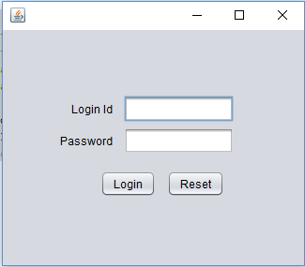

Slide 8
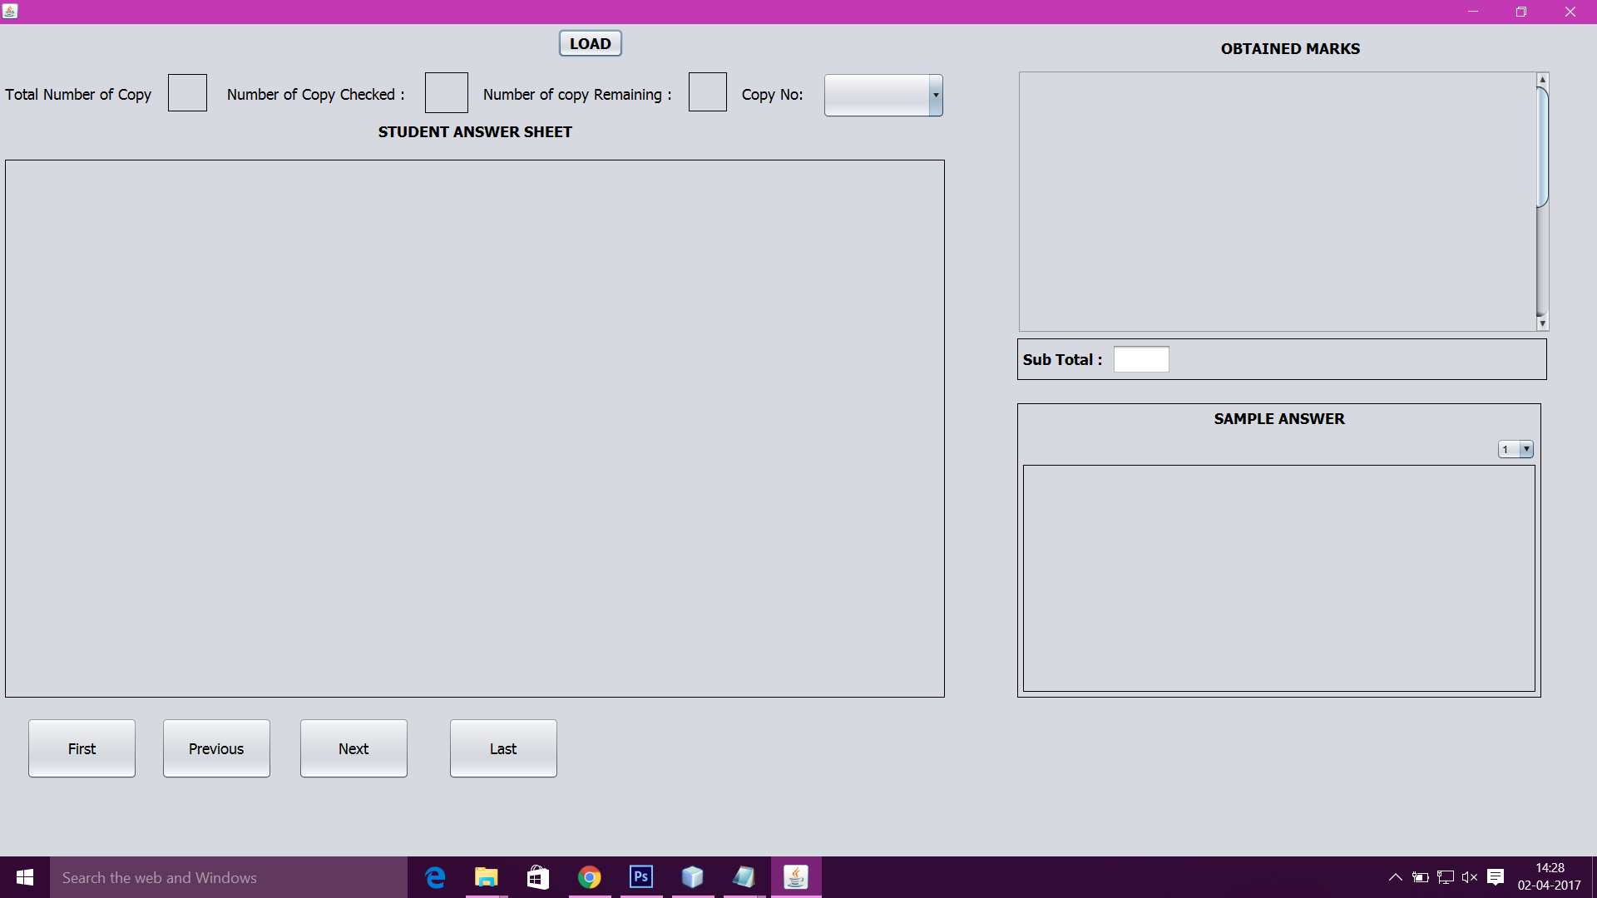

Slide 9
Dependencies
This system will be eliminating the evaluator’s manual work involved in arranging marking scheme as per the answer sheet.
Also it is accompanied with additional features leading to a more efficient, secure, economic and accurate evaluation system.
Show-Stopper
“Our solution is an extension to OSM, where it resolves the problems faced because of the randomness of the questions attempted by the students.”

